Slide 1
Building a 2D Physics Engine
Twannes Claes – Game Development
Notes:
Lately interested in physics programming since learning about the physx library

Slide 2
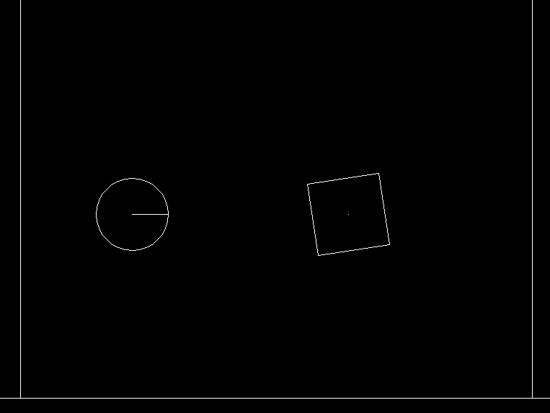
Final Result

Slide 3
Focus
Understanding the inner workings of a physics engine
Comparing and researching different calculations
Exploring how various shapes interact with each other
Researching solutions for a better simulation
Testing how to keep a deterministic simulation
Notes:
There are many different optimized 2D engine, my focus was learning how it fits together and starting to get to know the basics

Slide 4
Research Question
How do diverse shapes within a 2D physics engine impact simulation accuracy, computational efficiency, and deterministic physics?

Slide 5
Theoretical Study
Understanding rigid body kinematics
Calculations for collision detection and resolving
Difference between convex and concave polygons
Research different physics equations
Notes:
without amp1&2 it would’ve taken a long time to understand the math behind it.

Slide 6
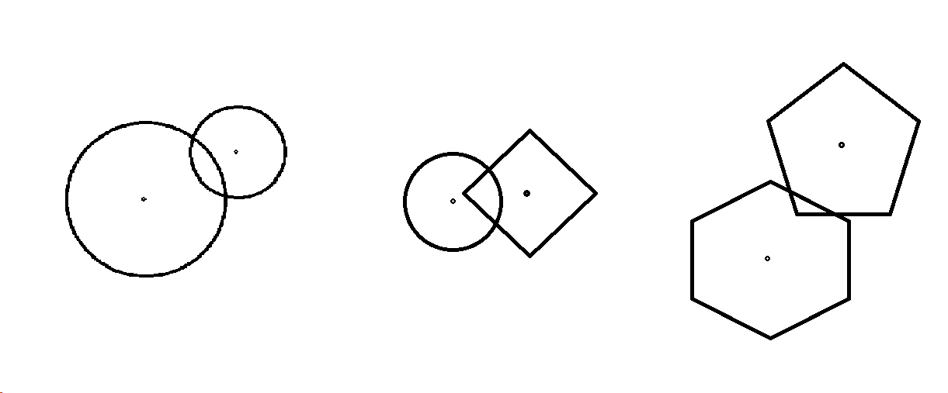
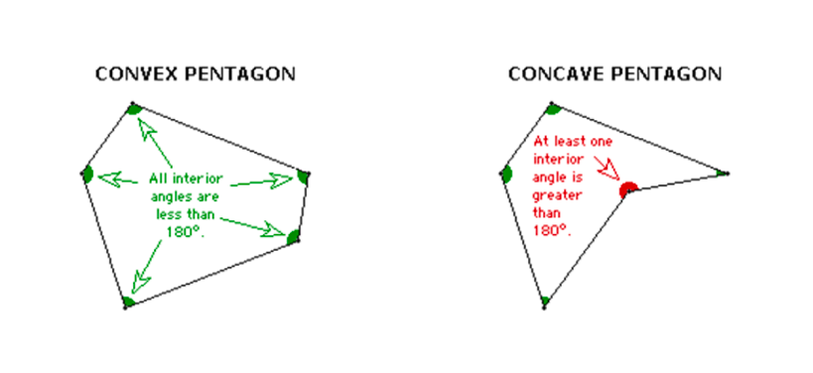
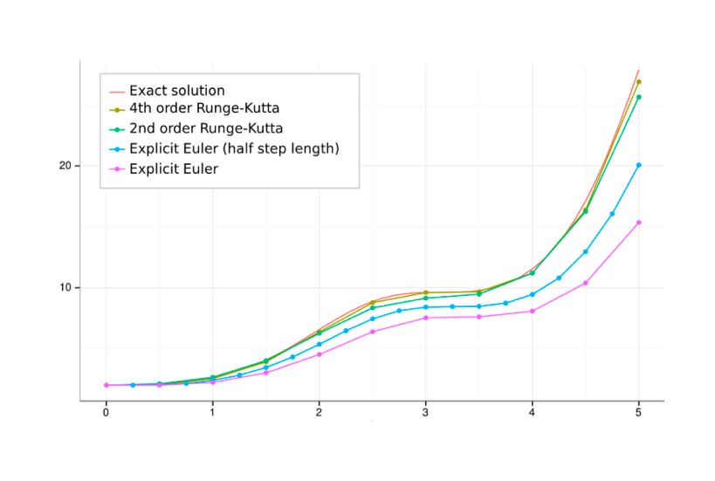
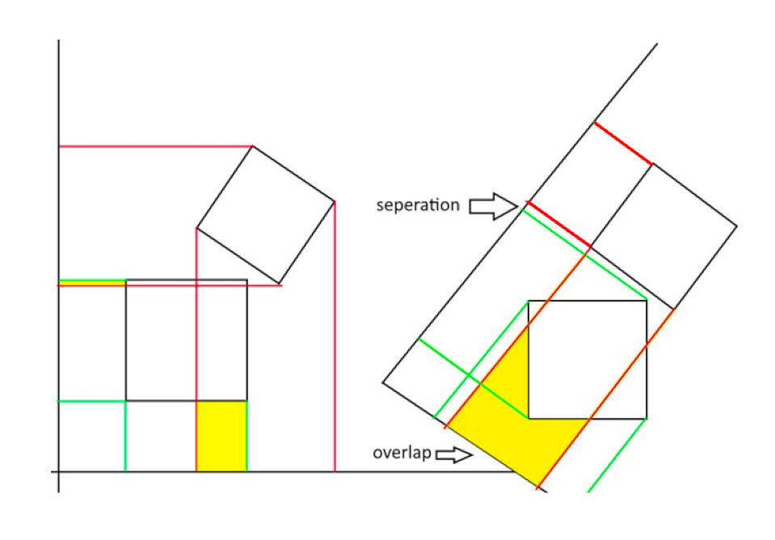

Slide 7
Research Scope
Stick to 2D
Leave out concave polygons
Collisions only
Minimal optimizations
Using external math library

Slide 8
Methodology
Built a framework with graphics, input, and math library
Game loop that can update and draw while adding objects during a running simulation
Set up a rigid body kinematics system
Set up a collision system
Set up scenarios to conduct experiments

Slide 9
Goals
Stable simulation where circles, boxes, and convex polygons interact in an intuitive way.
Doesn’t have to be optimized, but small optimizations are welcome.
Experiment with various shapes, to see what happens to the simulation qua complexity, performance, and accuracy.
Getting to understand the calculations for collisions and potential improvements.

Slide 10
Results Broad phase optimization

Slide 11
Results Performance/Complexity

Slide 12
Results Determinism

Slide 13
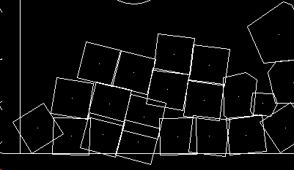
Results Accuracy

Slide 14
Conclusions
Circle collisions are cheap and can be utilized to optimize other collisions.
Complex shapes introduce more complexity and decrease performance.
A fixed time step will result in a deterministic simulation when following the correct rules.
Accuracy is determined by the physics equation, optimizations, and constraints.

Slide 15
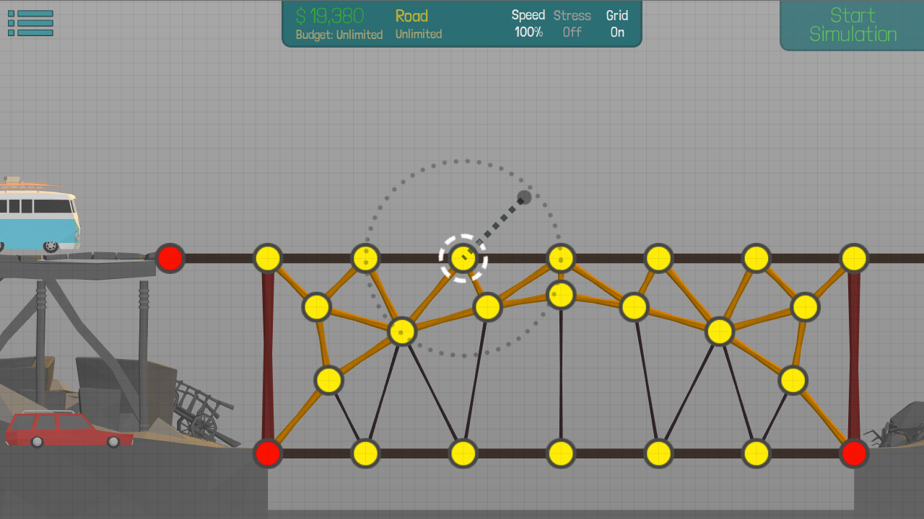
Future work
More stabilization and optimizations
Adding constraints
Joint logic, cloth simulation, ropes, chains

Slide 16
Personal growth
Physics programming experience
Time management and independent study
Academic writing experience

Slide 17
Any questions?
Thank you for listening

